Slide 1
Interview Techniques
By Eoin Godfrey

Slide 2
Introduction
For my interview skills class, I must analyse three interviews from different sections of media, in the three interviews that I have chosen, I will look at:
The Purpose of the Interview
Types of Questions
Target Audience
I will then present my findings from these three interviews to the rest of my class in the form of a PowerPoint presentation.

Slide 3
Interview 1: Purpose
This first interview is an moving image interview with presenter James Arnold Taylor and actor Mark Hamill that was filmed during one of the Star Wars fan conventions in America.
During this interview; Mark talks to James about his experience in the Star Wars films as well as his role in the new Star Wars film, “The Force Awakens” where he reprises his role as Luke Skywalker from the original films.

Slide 4
Interview 1: Types of Questions
The questions that Mark is being asked are open questions that involve his experience in the Star Wars films and about how his son was a big Star Wars fan when he was 3 years old, he also talks about the pictures that he has of him and his family on the set of “Return of the Jedi.” when it was being filmed.
Mark also talks about his role in the newest Star Wars film, “The Force Awakens”; where he reprises his role as Luke Skywalker, one of the characters from the original films; he states that returning to his role as Luke was a rush of nostalgia for him.

Slide 5
Interview 1: Target audience
The target audience for this interview with Mark Hamill would mainly be fans of the Star Wars films and anyone who is waiting of the release of the newest film “The Force Awakens”.
This interview is also aimed at fans of science fiction films and people who enjoy Mark Hamill’s work in other films and TV shows other than the Star Wars films.
https://www.youtube.com/watch?v=p-VQiOhsNmk

Slide 6
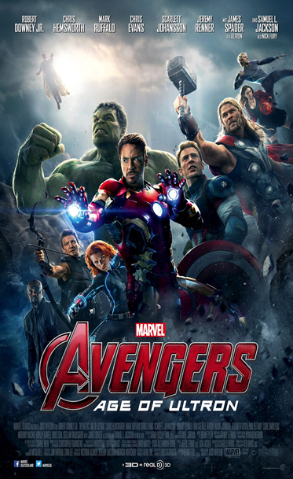
Interview 2: Purpose
This next interview is an interview with Robert Downey Jr; this is a moving image interview and was shown on Channel 4.
The interview’s original purpose was to promote the film “Avengers: Age of Ultron” which features comic book characters created by Marvel Comics and stars Robert Downey Jr in one of the leading roles.
However, the interviewer then begins to ask Robert more personal questions about his family and past; causing the actor to become uncomfortable and this then causes him to leave the interview altogether as a result.

Slide 7

Interview 2: Question Types
At the start of the interview; the interviewer starts off with lighthearted questions about “Age of Ultron” and characters that it is based on; the questions used in this part in the interview are open questions that are used to ask Robert some questions about the role that he has as Tony Stark, the character also known as Iron Man.
But as the interview with Robert goes on; the interviewer begins to ask some very aggressive and off-topic questions regarding Robert’s past, these questions were about information that was very personal to the interviewee.

Slide 8
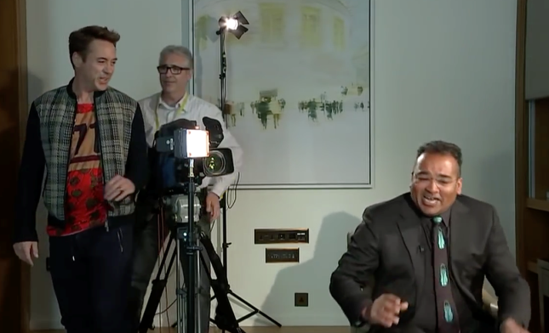
Interview 2: Target Audience
This interview with Actor Robert Downey Jr would have been targeted at the general audience of the news programme and viewers of Channel 4, another the target audience for this interview would have been comic book fans who were waiting for the release of “Age of Ultron” in the cinemas.
The interview also had a structure where the interviewer got the interviewee to answer the easy questions and then slowly went deeper in order to ask the interviewee more off topic questions that had no relevance to the interview’s purpose.
https://www.youtube.com/watch?v=ALBwaO-rAsE

Slide 9
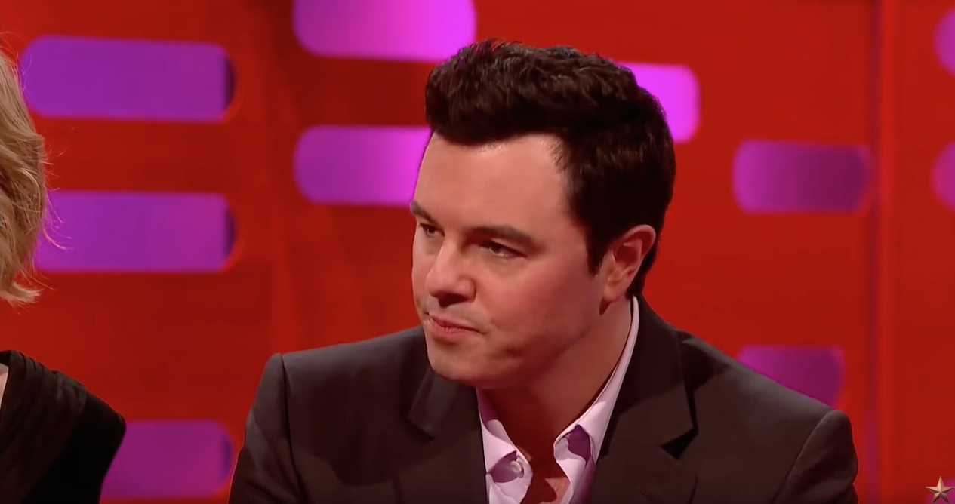
Interview 3: Purpose
This final interview is a moving image interview with Seth McFarlane; the creator of Family Guy on the Graham Norton Show on BBC.
In this interview, Seth talks about the origin of the different voices that he uses in Family Guy and also does impressions of the characters that he voices on the show such as Stewie and Peter Griffin.

Slide 10
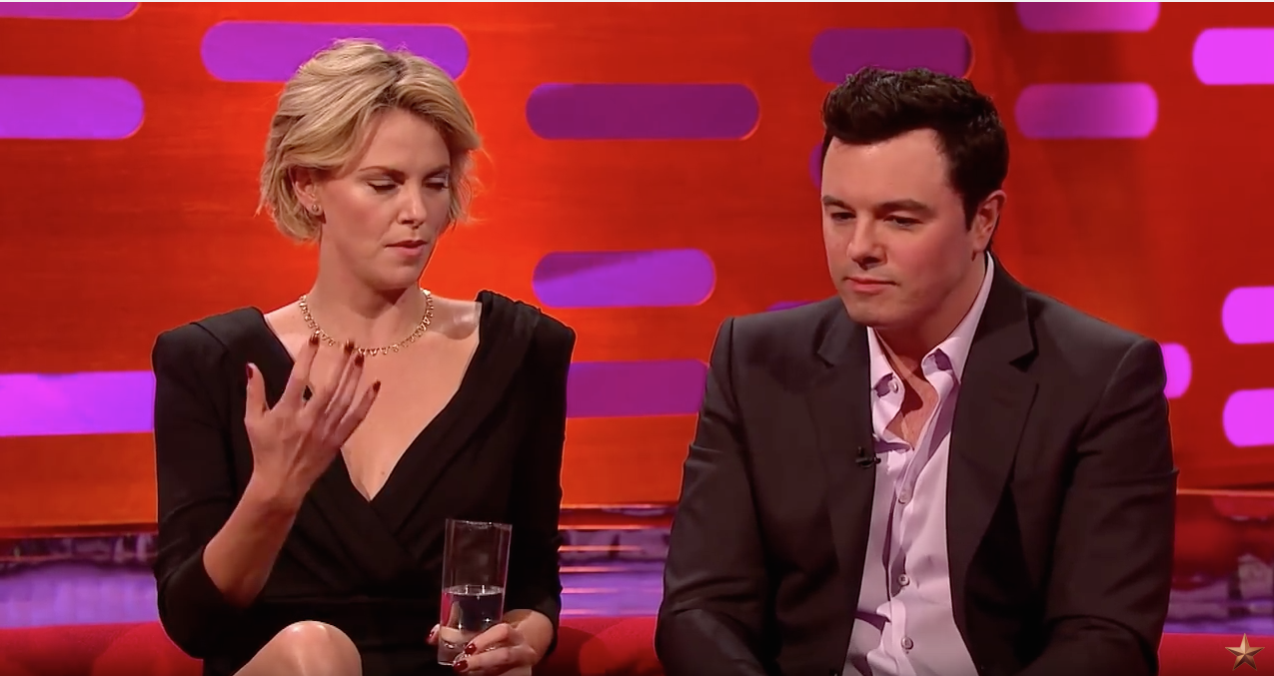
Interview 3: Question Types
The questions that are used in this interview are very open and light hearted, as Graham and Seth have a good laugh with each other as they talk about the voices that are used in Family Guy and as Seth is doing his impressions of different characters such as Peter Griffin and Kermit the Frog.

Slide 11
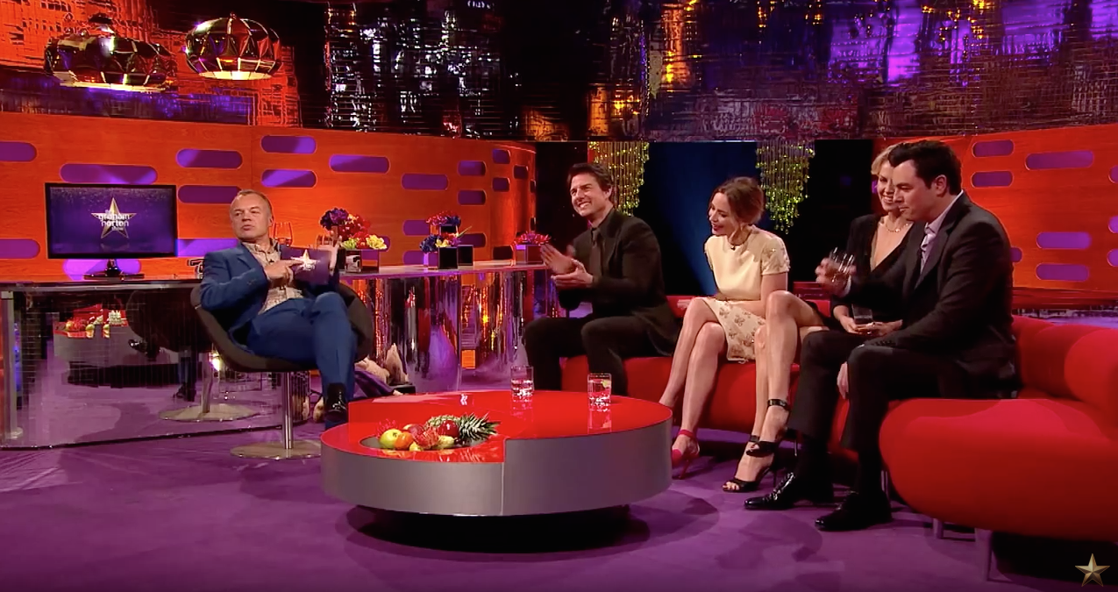
Interview 3: Target Audience
The target audience of this interview is the viewers of the Graham Norton show and also the general audience of the BBC altogether. Another target audience of this interview from the Graham Norton Show would be fans of the Family Guy TV series that Seth McFarlane created.
https://www.youtube.com/watch?v=AP_aom1IgqI

